Slide 1
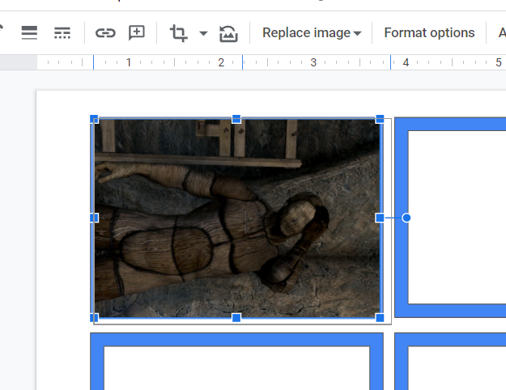
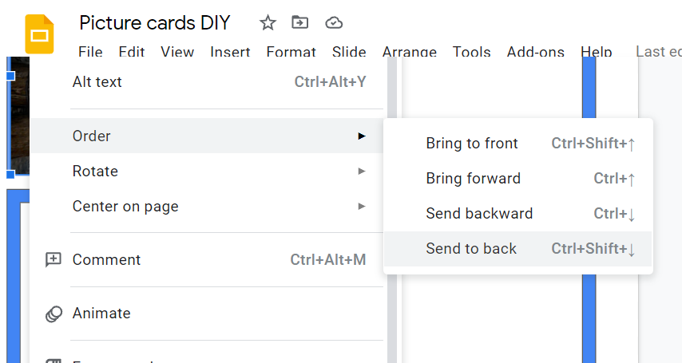
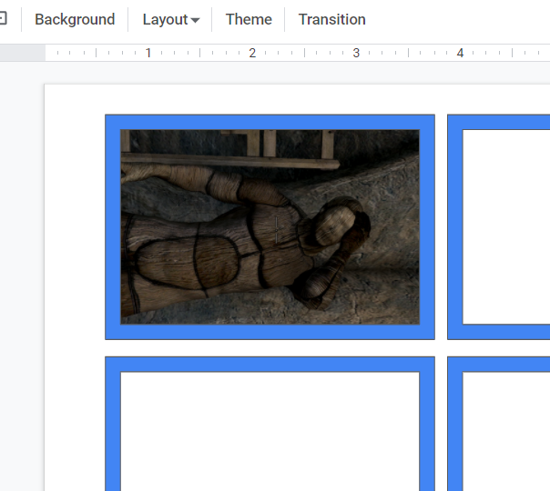
How to make your own framed picture cards:
Take the image you want and manipulate it to match the size of the blue box.
2. Click on the image and send it back, which will put it behind the frame.
3. Voila! You have a picture card! Now to this a bunch of more times and print them out!

